Slide 1
Aviation Flight Status:
Flight Boards, Voluntary Termination and Waivers
COMMANDERS’ COURSE
ASM-52
LtCol Art “Rico” Behnke

Slide 2
Purpose
Provide Commanders with an overview of aviation flight status issues
  Field Flight Performance/Flight Status Selection Boards (FFPB/FSSB)
    Review of orders and summary of adjudication
    FITREP Reporting
    FFPB Issues seen at HQMC
  Voluntary Termination (Revocation) of Flight Status
  Waivers
    DIFDEN
    Min Flt Time
    Flt Phys

Slide 3
FFPB Order / Background
MCO P1000.6G (ACTS Manual)
  Sect 1214 (Field Flight Performance Board):
    An FFPB is convened to evaluate the performance, potential and motivation of a respondent ordered by competent authority to appear before the board.
    A means to uphold established standards in flight performance, maturity and discipline and to prevent those aircrew-caused mishaps that can be anticipated through early identification of substandard performers.
  Sect 1215 (Flight Status Selection Board)
    The purpose of the FSSB is to enable CMC to take proper administrative action and to assist in maintaining a combat ready and effective crewmember force.
Notes:
Accountable, responsible,

Slide 4
FFPB – 6 Results
No further Action Required
  Aircrew did not require further training or administrative action
Further Training, Conversion or Transition Training
  Further training by default is at least Conditional
  T/C training will be approved through FSSB/CMC action
Conditional Flight Status
  Aircrew required additional training but no administrative action
Probationary Flight Status
  Aircrew required additional training, adverse administrative action
Revocation of Flight Status
  Aircrew were beyond training, adverse administrative action Rqd
Revocation of Flight Status & Wings
  Discredit to Marine Aviation, adverse administrative action Rqd
  ------------------------------------------------------------------------------------------------------------------------------------------------------------------------------------------------------
Transition/Conversion
  Aircrew were not AA in specific T/M/S (Anthros, Airsickness)
DC/A
Decision

Slide 5
FFPBs and FITREPs
DC FITREPs MCO 1610.7F -- 3004.2.c(9)
  Probation vs. Conditional status
Directed Comments 4012.4.b(5) & 4012.5.a(3)
  Only if the MRO is found to be negligent, culpable or terminates and/or restricts flight status of the MRO
    Referencing an informal investigation (i.e. FFPB) without the above is unacceptable
Adverse Reports 5001.3.d(6)
  Adverse for unwillingness or cavalier attitude
  Not adverse for lack of specific ability or aptitude
  Bottom Line: Leadership

Slide 6
FFPB Issues Seen at HQMC
Delays in execution and routing of FFPB
Incorrect FFPB procedures
  No Convening Message / Notice received at HQMC
  Respondent did not review FFPB report prior to submission
  No Flight Surgeon Evaluation / Incomplete evaluation
Respondents facing Revocation utilized to fill IA billet
  Revocation equals MOS reassignment in most cases
Conditional / Probationary Flight Status
  ADP may not be transferred until board process complete
Poor documentation of case
Command too willing to point finger at Respondent
  Not enough opportunities to correct deficiencies
    Not enough documentation of training
ACIP suspension?
  CO’s decision

Slide 7
Voluntary Termination
Administrative process
Contained in ACTS manual 1213.1.c
  Immediately suspend SNM/ADP from flight status
  Direct SNM to submit VolTerm letter w/in 5-days
  3 MOSes
  Flight Surgeon report
  CO must counsel SNM
    CO’s endorsement
      Include the counseling in endorsement → Considered Permanent
      Effective date of flight suspension & termination of ACIP
  -----------------------------------------------------------------------------------------------------------------------------------------------------------------------------------------
  Respondents reasoning/rationale for VolTerm

Slide 8
Waivers
DIFDEN MCO 3710.4A
  A/C Custodian AND Immediate CO, route through Aviation CoC
    Single Flight/Series of Flights
    Flight Experience Utilized
Minimum Flight Time Waiver Request OPNAV 3710.7U
  Example in 3710 (Sec 11.5)
Flight Physicals (chap 8)
  CMC(ASM) grants medical waivers (NAMI only recommends)
NASTP (chap 8)
  CMC(ASM) will grant “Dirt Det” Waiver only (Limited over water)
  90 day extension POST deployment
  Orientation Flights (p. 3.7)
Flight Gate (M&RA, not ASM)
  SECNAV approval (Direct to MMOA)

Slide 9
Flight Violation Handling
OPNAVINST 3710.7U (pp. 3-20 to 23, para. 3.11)
Inform CoC
Contact FAA
  Local representative / USMC ACDU representative
  FAA may still escalate the alleged violation
Conduct investigation, if required
Conduct FFPB / corrective actions, if required
Alleged violation to OPNAV N-88, Mike Lister
OPNAV letter
Command response to N-88, route through CoC
OPNAV letter to FAA

Slide 10
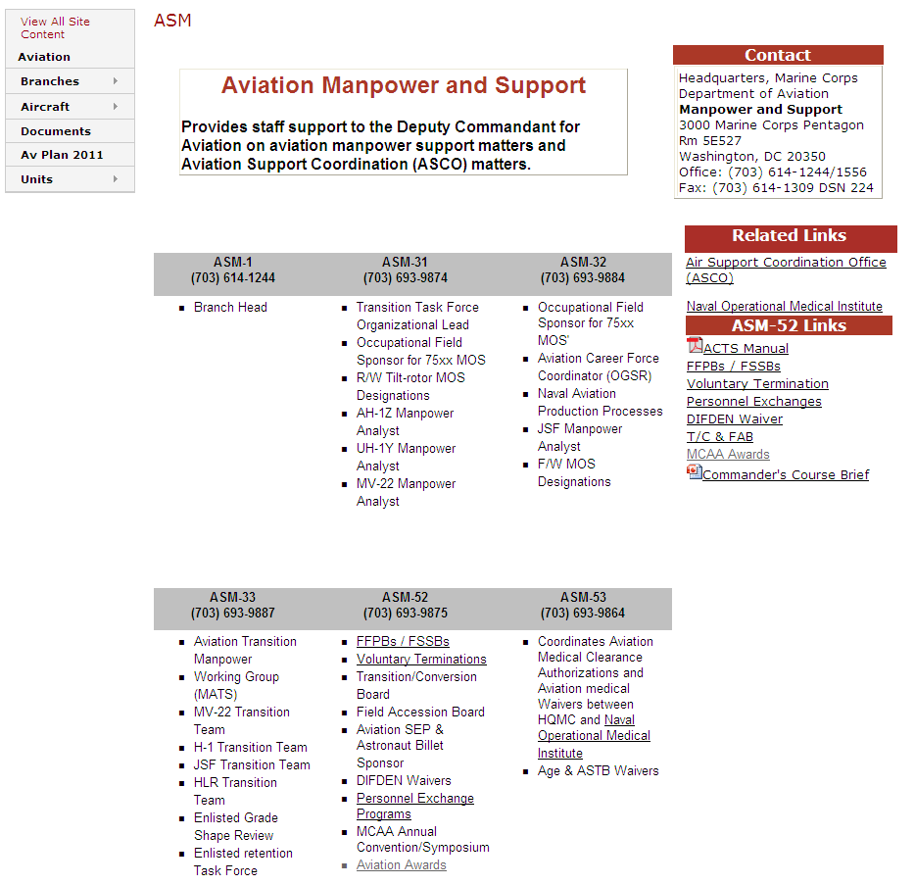
ASM Website
http://www.marines.mil/unit/aviation/Pages/ASM.aspx

Slide 11
Takeaways
Seek ASM for difficult scenarios.
Recommendations of Probation, Revocation or T/C will go to FSSB for DC AVN adjudication
Timely submission of FFPB and endorsements
  Voluntary Terminations
ADP suspended from flying until resolution
Use the ASM Website

Slide 12
Questions?
LtCol Art “Rico” Behnke
ASM-52
703-614-1556/1244
DSN 224 http://www.marines.mil/unit/aviation/Pages/ASM.aspx

